Slide 1
Geoduck as indicators of environmental change
Exploring CHANGES IN PROTEOMIC SIGNALS BETWEEN habitats
LAURA H SPENCER
MASTERS CANDIDATE
SCHOOL OF AQUATIC & FISHERY SCIENCES
UNIVERSITY OF WASHINGTON

Slide 2
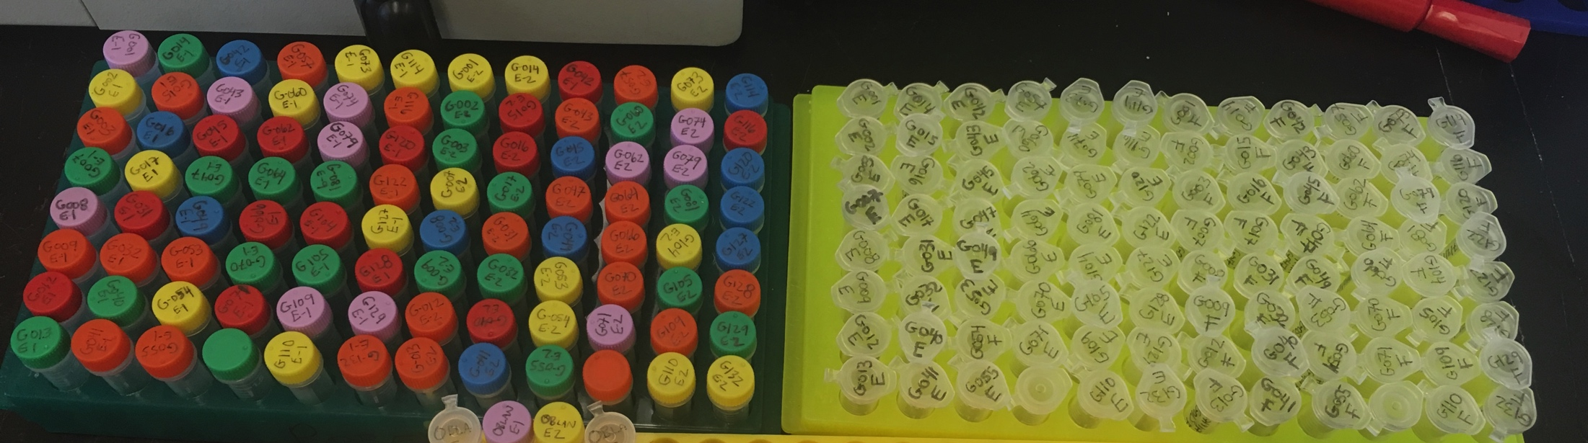
Questions: Gill proteins as bio-assays?
Can we use proteins as bio-indicators of environmental stress in geoduck?
Which proteins of interest can we clearly detect?
Can we detect differences in protein composition in geoduck from different habitats, sites?

Slide 3
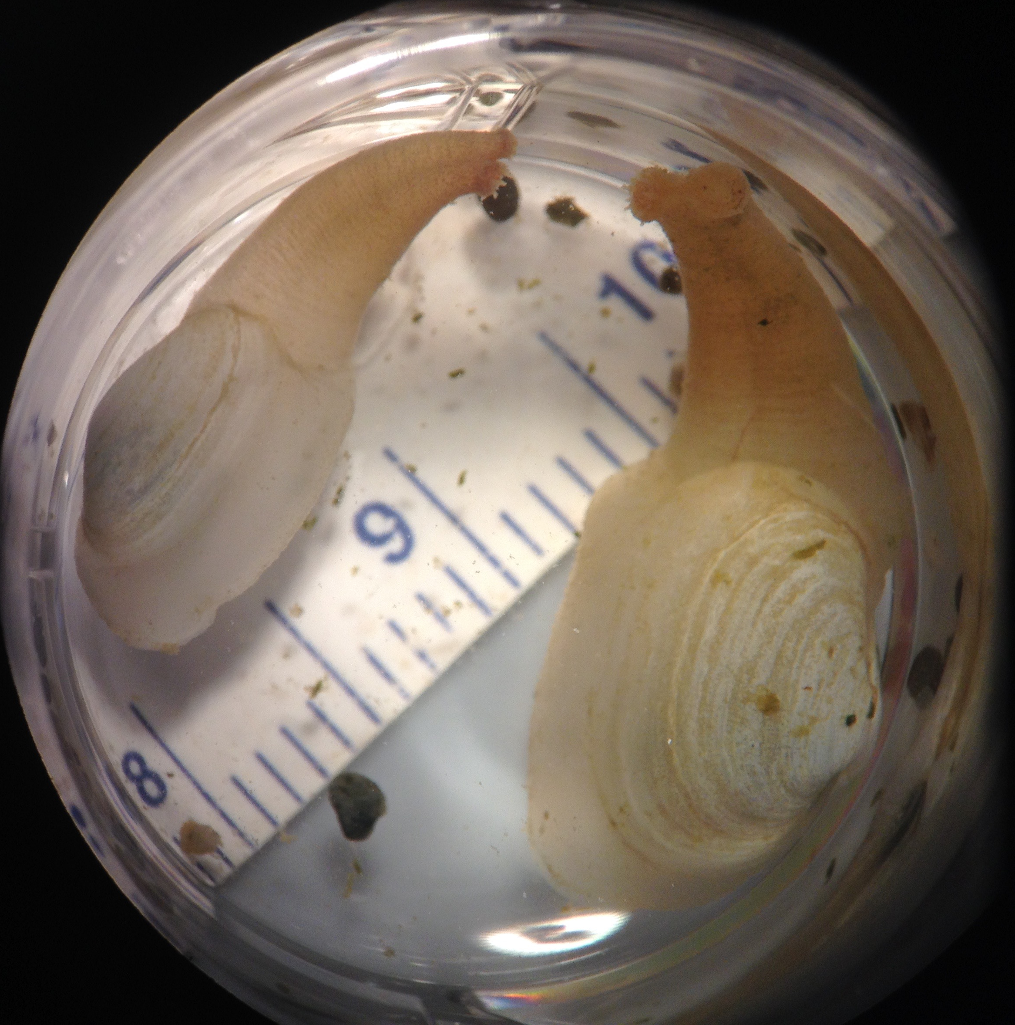
THE GEODUCK Panopea generosa
Native to WA
Largest burrowing clam in the world
Wild stock landings (2015): 4.936M lb, $41M (WDFW)
Highly valuable aquaculture species with growing industry; 27% shellfish aquaculture revenue (2013)
This study: sibling juvenile geoduck seed provided by Taylor Shellfish hatchery

Slide 4
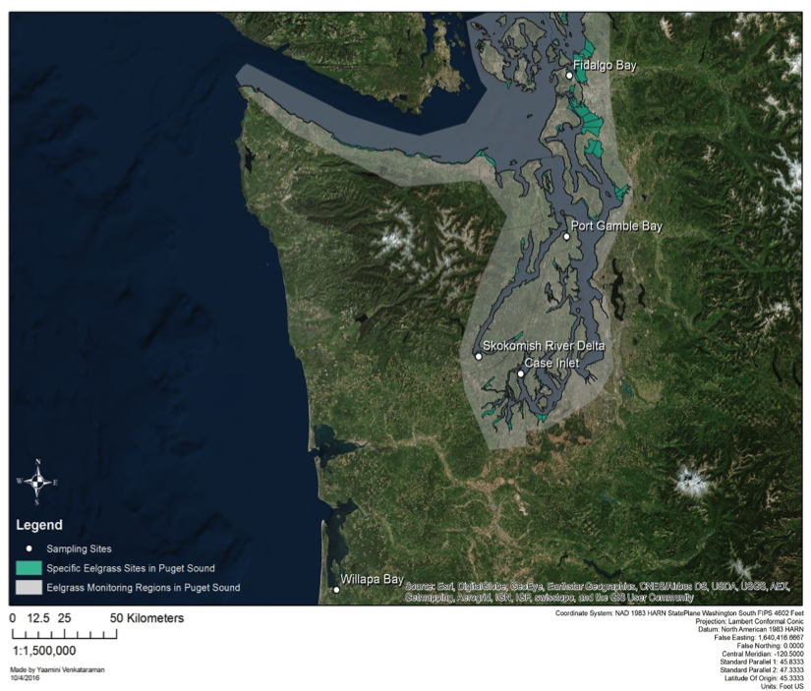
5 SITES Puget Sound & Willapa Bay
Fidalgo Bay
Port Gamble Bay
Skokomish
River Delta
Case Inlet
Willapa Bay

Slide 5

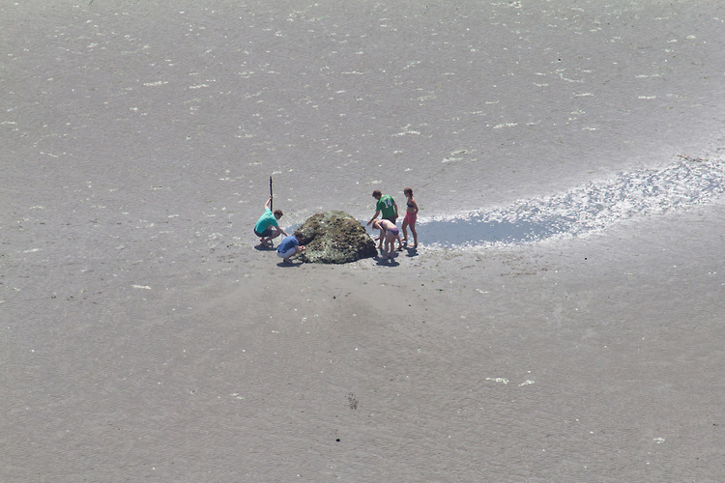
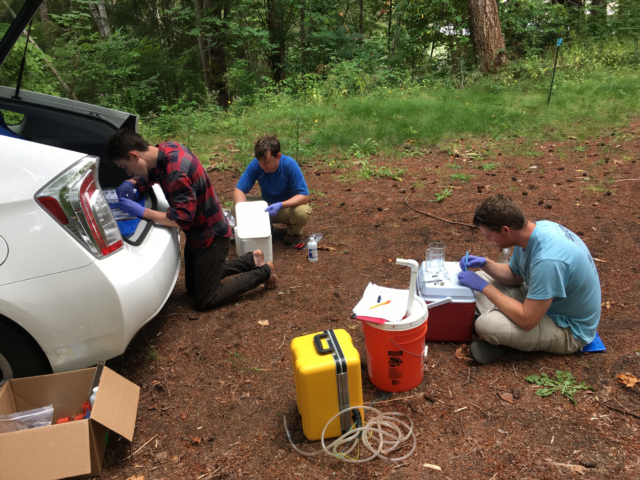
Experimental Outplant: 2 treatments
1 month (June, August)
n=20 in 4 PVC enclosures per location
Durafet, Seabird CTD for pH, temperature, salinity, depth, chlorophyll
Measured growth, dissected and sampled ctenidia, frozen on site.
Extracted proteins, digested & isolated peptides via Mini-Trypsin digestion
PROBES
PROBES
EELGRASS BED
BARE SEDIMENT

Slide 6
Protein analysis in 2-phases
PHASE I
DATA INDEPENDENT ANALYSIS
(DIA)
PHASE II
SELECTED REACTION MONITORING (SRM)
Orbitrap Fusion Lumos machine
No pre-selected precursor ions needed
Captures all peptides within designated mass/charge ratio (m/z)
TSQ Vantage machine
Requires pre-selected list of transitions (m/z, retention time)
Captures precise & sensitive quantitative data
Identify & quantify peptides via
MS/MS
PECAN
Survey peptides against annotated background proteome
Generate summary file for direct use in Skyline
PRTC, internal peptide standard
Regress RT from SRM against DIA to confirm peptide identities
Also perform dilution curve with known protein concentrations
Identify proteins in samples & quantify
Skyline
Visualize results, check peak selection error rate
Identify peptides with strong signals
Skyline
Quality control all peak selections
Remove poor-quality peaks
Quality Control
Normalize abundance via standard
Assess technical rep quality
Assess dissimilarity via NMDS
ANOSIM for site/treatment similarities
Annotate proteins with GO
Assess differential expression (NMDS)
Identify interesting proteins with strong clear signals
DATA ANALYSIS
Notes:
Used MS/MS to identiy and quantify proteins in our samples

Slide 7
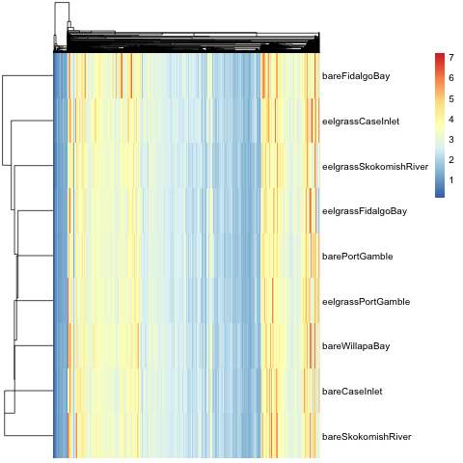
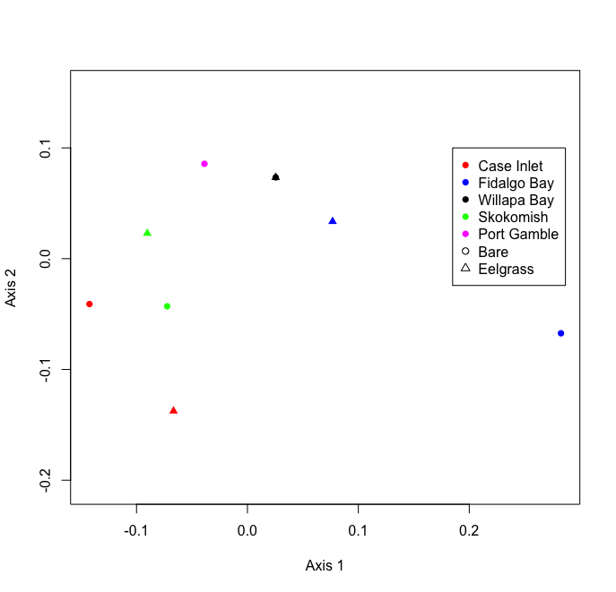
Phase I Shotgun Proteomics Results
10 samples analyzed, 1 per site/treatment
8,076 proteins, 5,690 annotated
NMDS plot represents overall similarity between samples
Clustering by site more than treatment
Heat Map, all proteins by site
Non-metric multidimensional scaling plot (NMDS)
Notes:
Heat Map showing protein distribution, where all 8k proteins along x axis, color indicates normalized quantity, organized by sample along the y axis. Similar pattern among samples, which is good indication that our data successfully represents abundance. There are some differences, which are to be expected.
We examine dissimilarity in plot on right, which is a Non-metric multi-dimensional scaling plot, which you’ll see again so I’ll describe it in a bit more detail. This plot represents overall similarity between sample. Pints represent samples, and the closer 2 points are together, the more similar their protein abundance patterns.
This is an ordination plot, where essentially each peptide is a dimensions, samples are placed along these many dimensions, assigned ranks based on similarity to other samples, then dimensions are transformed, are distilled down to 2 dimension.

Slide 8
Proteins selected for Phase 2
PROTEIN | Response to… | Uniprot ID
Heat Shock Protein 90-alpha | Stress | P30946
Heat Shock Protein 70 | Stress | Q91233
Superoxide Dismutase | Oxidative stress | P28757
Catalase | Oxidative stress | P00432
Peroxiredoxin-1 | Oxidative stress | Q6B4U9
Puromycin-sensitive aminopeptidase | Oxidative stress | Q11011
Protein disulfide-isomerase | Oxidative stress | P07237
Ras-related protein Rab-11B | Acidic pH | O35509
Sodium/Potassium-transporting ATPase subunit alpha | pH changes | Q13733
Cytochrome P450 | Toxins | P00185
Arachidonate 5-lipoxygenase | Inflammation | P09917
Glycogen Phosphorylase (muscle form) | Carbohydrate metabolism | Q9WUB3
Trifunctional enzyme subunit beta (mitochondrial) | Lipid metabolism | O46629

Slide 9
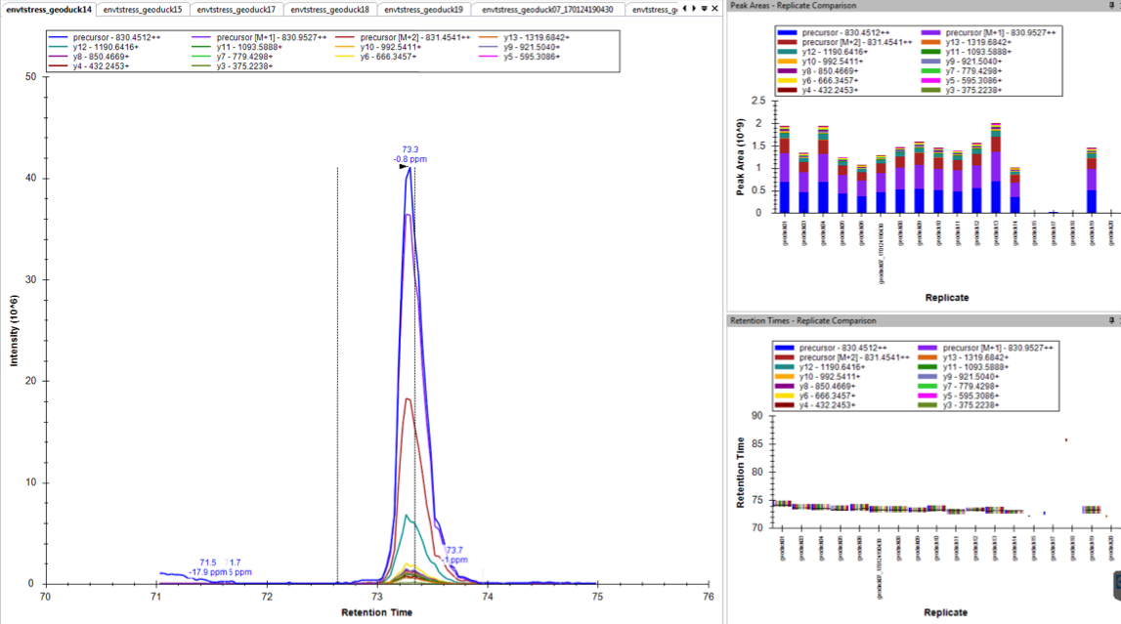
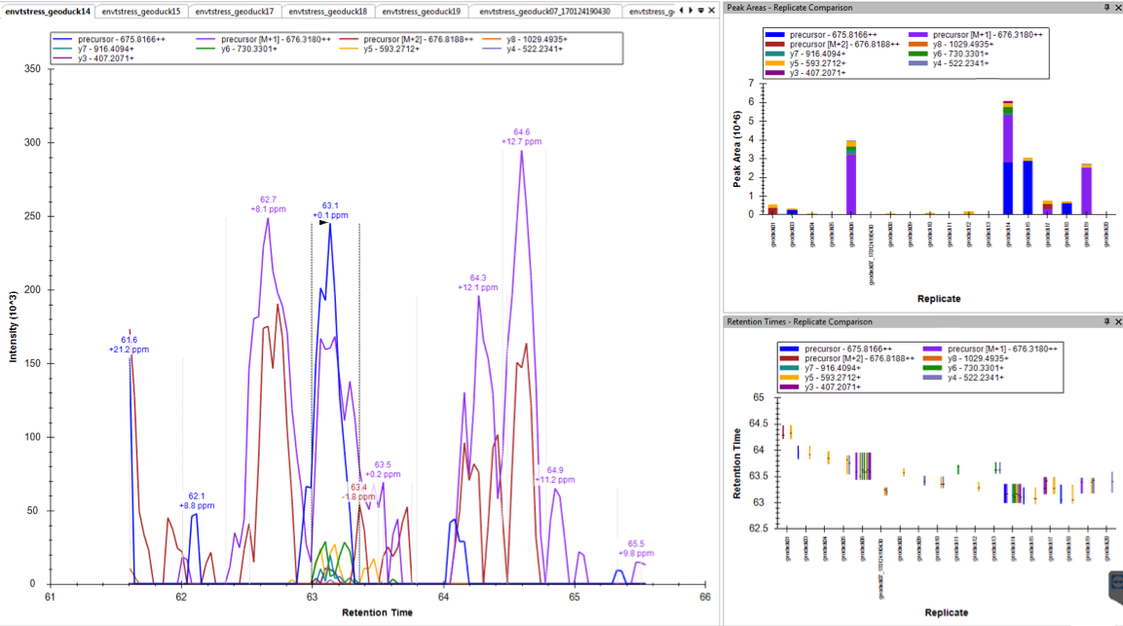
Selected proteins have strong, clear signal
gigasin
Poor quality
Good quality
Heat Shock Protein 70

Slide 10
Protein analysis in 2-phases
PHASE I
DATA INDEPENDENT ANALYSIS
(DIA)
PHASE II
SELECTED REACTION MONITORING (SRM)
Orbitrap Fusion Lumos machine
No pre-selected precursor ions needed
Captures all peptides within designated mass/charge ratio (m/z)
TSQ Vantage machine
Requires pre-selected list of transitions (m/z, retention time)
Captures precise & sensitive quantitative data
Identify & quantify peptides via
MS/MS
PECAN
Survey peptides against annotated background proteome
Generate summary file for direct use in Skyline
PRTC, internal peptide standard
Regress RT from SRM against DIA to confirm peptide identities
Also perform dilution curve with known protein concentrations
Identify proteins in samples & quantify
Skyline
Visualize results, check peak selection error rate
Identify peptides with strong signals
Skyline
Quality control all peak selections
Remove poor-quality peaks
Quality Control
Normalize abundance via standard
Assess technical rep quality
Assess dissimilarity via NMDS
ANOSIM for site/treatment similarities
Annotate proteins with GO
Assess differential expression (NMDS)
Identify interesting proteins with strong clear signals
DATA ANALYSIS

Slide 11
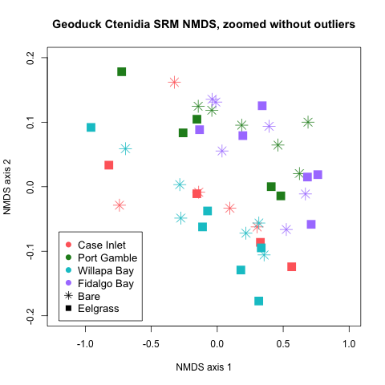
SRM Results Site Differences
All proteins represented in results
80% peptides have clear signal
NMDS plot represents overall similarity between samples
Clear clustering by site

Slide 12
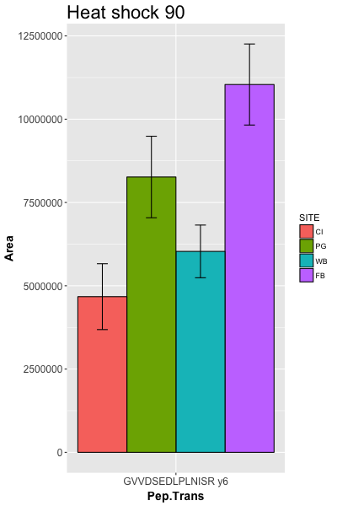
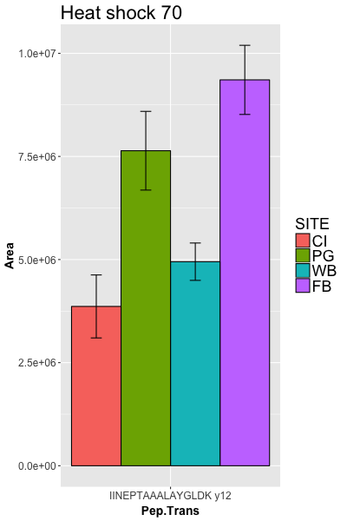
Mean abundance by site General Stress proteins
Heat shock complexes refold & facilitate degradation of damaged proteins
Highest abundance in N. Puget Sound: Port Gamble & Fidalgo Bay
Pattern consistent across 2 stress proteins

Slide 13
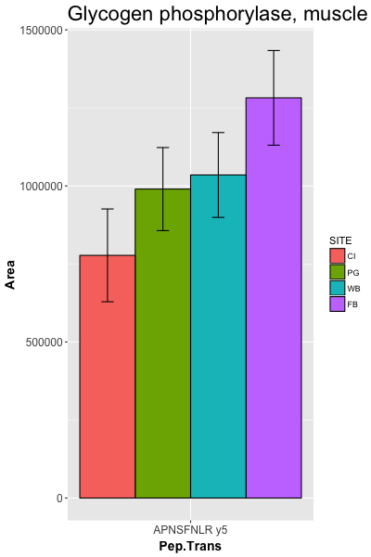
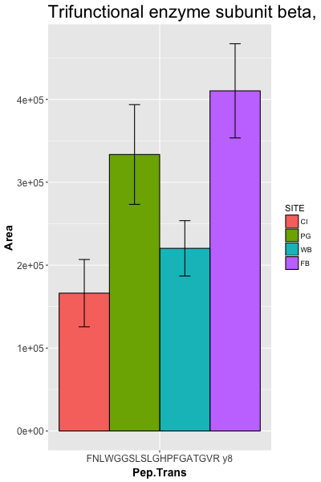
Mean abundance by site Metabolic enzymes
Carbohydrate: feeding on algae
Lipid: using stored energy
Interesting difference between 2 metabolic pathways
Carbohydrate metabolism
Lipid
metabolism

Slide 14
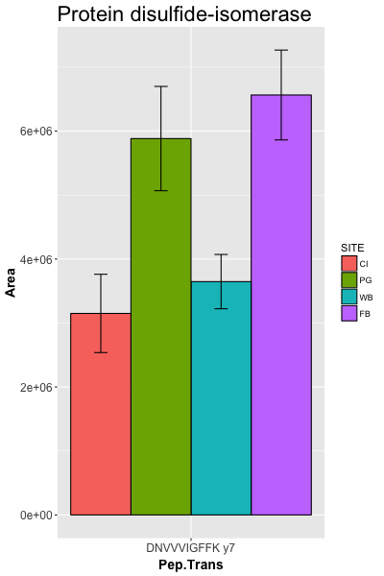
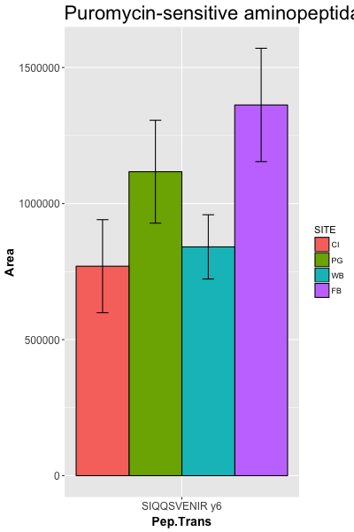
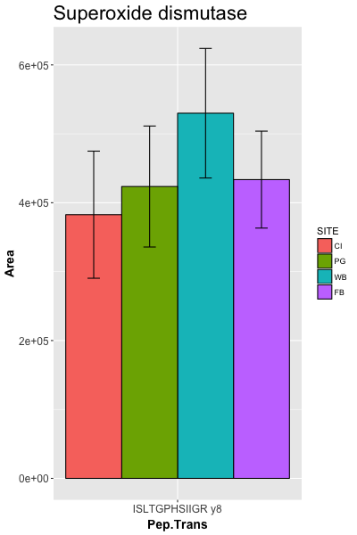
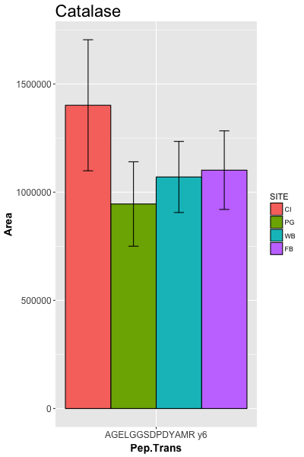
Mean abundance by site Antioxidant Enzymes
Both enzymes protect against free radicals from cell damage
High DO concentrations in Fidalgo Bay may be culprit
pH changes

Slide 15
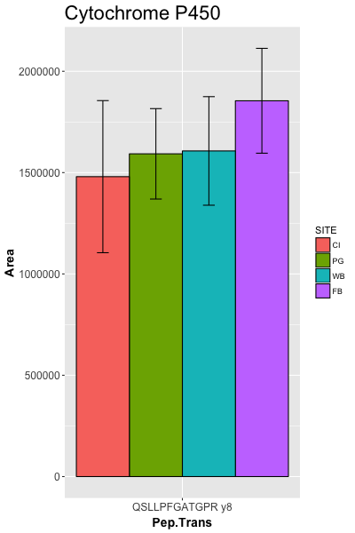
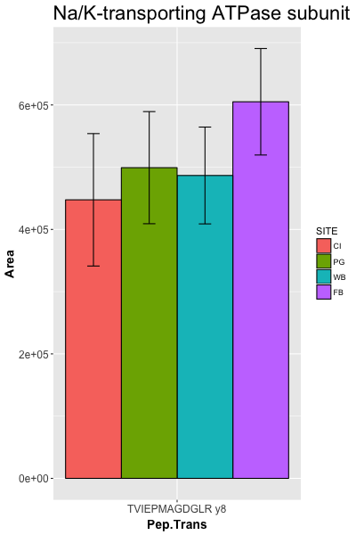
Mean abundance by site Etc.
Interesting unique pattern among sites
Toxins
pH regulation

Slide 16
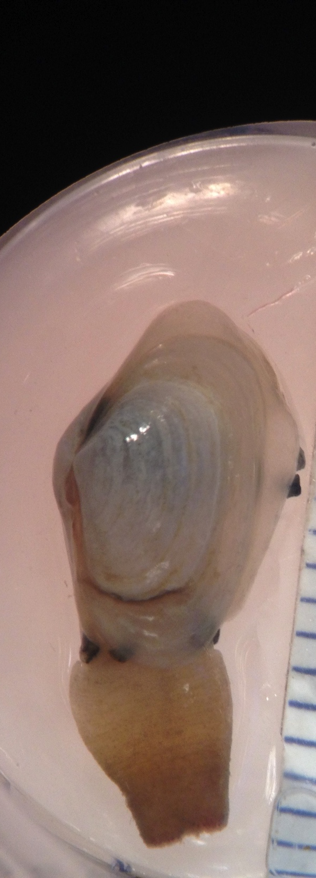
Conclusions & Next Steps
Neat Findings
Clear physiological differences between sites, manifested
in 1 month in sibling juvenile geoduck
High activity in Fidalgo Bay & Port Gamble Bay
All targeted proteins quantified, 80% success rate for transitions
5,690 DIA annotated proteins are available for more SRM projects
Next steps
Re-asses DIA results using new ctenidia transcriptome
Repeat outplant for longer duration
Re-run samples with new protein targets
Overlay with environmental data
Assess proteins for use as assay

Slide 17




Thank you…
… to my collaborators
Emma Timmins-Schiffman & the rest of the Brook Nunn lab (UW Genome Sciences)
Micah Horwith, WA DNR
Alex Lowe, UW Biology
Yaamini Venkataraman, Jose Guzman, Grace Crandall, Steven Roberts @ UW SAFS
… to you; please provide feedback!
Notes:
NEED STILL:
* Temp & DO data to explain patterns?
*

